Slide 1
CSE 1102 Fundamentals of Programming Lecture #4
Spring 2017
Computer Science & Engineering Program
School of Electrical Engineering & Computing
Adama Science & Technology University

Slide 2
Basic C++ Programming Practice
Finding Errors
Syntax Errors
Runtime Errors
Heat Transfer Case Study
Size of Data Types
Practice Exercise 1
Practice Exercise 2
General Problems(Maths and Physics)

Slide 3
Syntax Errors
Code::Blocks shows errors using the red marker
The top most error shows up first
See error details in the log window

Slide 4
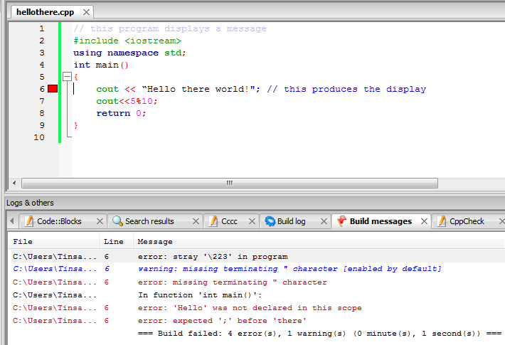
Syntax Errors
The first error is corrected, now it moves to the next error

Slide 5
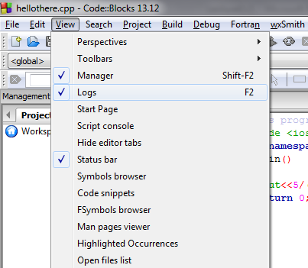
Can’t See Logs
If you can’t see the build messages, make sure the Logs is checked on View menu

Slide 6
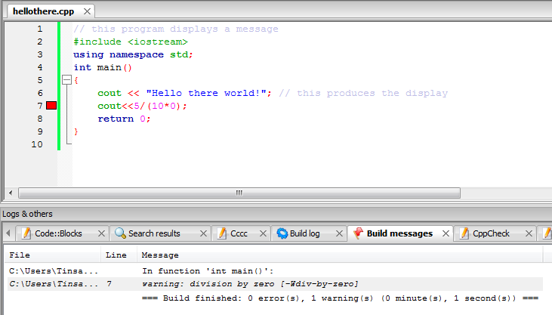
Run-time Errors
The Program will break and code::blocks shows you a warning for the next build

Slide 7
Case Study: Heat Transfer
In Lecture 1 you developed simple algorithm for the heat transfer problem
Finish the remaining steps
Coding
Testing

Slide 8
Size of Data Types
A unique feature of C++ is that you can see where and how values are stored
sizeof() operator provides the number of bytes used to store values of the data type named in the parenthesis
Values returned by sizeof() are compiler dependent

Slide 9
Size of Data Types

Slide 10
Practice Exercise 1
Using cout, write a C++ program that displays your name on one line, your id number on a second line, and your city, region, and phone number on a third line
Run the program

Slide 11
Practice Exercise 2
For the following correct algebraic expressions and corresponding incorrect C++ expressions, find the errors and write corrected C++ expressions in one C++ program
Algebra | C++ Expression
(2)(3)+(4)(5) | (2)(3)+(4)(5)
$$\frac{6+18}{2}$$ | 6+18/2
$$\frac{4.5}{12.2−3.1}$$ | 4.5/12.2-3.1
4.6(3.0+14.9) | 4.6(3.0+14.9)

Slide 12
Practice Exercise 2…
Write a C++ program that displays the results of the expressions
3.0*5.0,
7.1 * 8.3 - 2.2
3.2 / (6.1 * 5).
Calculate the value of these expressions manually to verify that the displayed values are correct.

Slide 13
General Problems
Design, write, compile, and run a C++ program that calculates and displays the area of a triangle, with a base of 1 in and a height of 1.5 in.
$Area=1/2\left(base\right)x(height)$
Test the program with different values

Slide 14
General Problems
Design, write, compile, and run a C++ program to calculate the volume of a sphere with a radius, r, of 2 in.
Test the program with different values
$$volume=\frac{4πr^{3}}{3}$$

Slide 15
General Problems
Design, write, compile, and run a C++ program to calculate the elapsed time it takes to make a 183.67-mile trip. This is the formula for computing elapsed time
elapsed time = total distance / average speed
The average speed during the trip is 58 mph.
Test it with different average speeds

Slide 16
General Problems
Write a program that accepts the value of temperature in Fahrenheit and converts to its Celsius equivalent. (hint C=F-32*5/9)
Test it with different temperatures

Slide 17
General Problems
Swap the contents of two variables using a third variable.
Swap the contents of two variables without using a third variable.

Slide 18
General Problems
Suppose that the cost of sending an international fax is calculated as follows: The service charge is ETB 3.00, 20 cents per page for the first 10 pages, and 10 cents for each additional page. Write a C++ program that asks the user to enter the number of pages to be faxed. The program then uses the number of pages to be faxed to calculate the amount due.

Slide 19
General Problems
Write a program that evaluate the followings expression by accepting the necessary values from the keyboard:
$$C=\sqrt{a^{2}+b^{2}}$$
Y = 5x²+9x-35

